Slide 1
Create CHATBOT IN PYTHON
PRESENTED BY:
S MOHAMED ASLAM
912421104021

Slide 2
PhaSe 2 : Innovation

Slide 3
Introduction:
In this phase, we will explore innovative techniques such as ensemble methods and deep learning architectures to improve the prediction system's accuracy and robustness. We will also consider using pre-trained language models like GPT-3 to enhance the quality of responses. Finally, we will put our design into innovation to solve the problem, and document the complete steps taken for assessment.

Slide 4
Putting Design into Innovation:
Problem Statement
Research and Analysis
Design and Development
Implementation and Testing
Documentation
Assessment

Slide 5
Problem Statement:
In this phase, we will explore innovative techniques such as ensemble methods and deep learning architectures to improve the prediction system's accuracy and robustness. We will also consider using pre-trained language models like GPT-3 to enhance the quality of responses. Finally, we will put our design into innovation to solve the problem, and document the complete steps taken for assessment.

Slide 6
Research and Analysis:
The first step in the design and development phase is to conduct thorough research and analysis to determine the feasibility and effectiveness of the proposed innovations. We will review existing literature and case studies on ensemble methods, deep learning architectures, and pre-trained language models to understand their potential benefits and limitations for our prediction system. We will also analyze the data sets and identify any potential biases or gaps in the data that could impact the accuracy and robustness of the system.

Slide 7
Design and Development:
Based on the research and analysis, we will design and develop a new prediction system that incorporates the advanced techniques identified in the previous phase. We will create a detailed plan outlining the steps involved in implementing the new system and ensure that it aligns with our goals and objectives. We will also establish benchmarks and metrics to measure the effectiveness and success of the new system.

Slide 8
Implementation and Testing:
Once the system has been designed and developed, we will move on to the implementation and testing phase. During this phase, we will deploy the system in a live environment and test its performance under real-world conditions. We will also conduct extensive testing to ensure that the system is accurate, reliable, and robust. This testing will involve using a variety of data sets and performance metrics to evaluate the system's performance and identify areas for improvement. We will work closely with the client to ensure that the system meets their requirements and expectations.

Slide 9
Documentation:
In this phase, we will create a comprehensive document outlining the complete steps taken to put our design into innovation and solve the problem.
This documentation will include detailed descriptions of the system's components, algorithms, and performance metrics.
We will also provide user manuals and technical documentation to help the client understand how to use and maintain the system. This documentation will be critical for future maintenance and upgrades to the system. This document will be shared for assessment.

Slide 10
Assessment:
After completing the implementation and testing phase, we will create a detailed document outlining the complete steps taken to put our design into innovation and solve the problem. This document will include a summary ofthe problem statement, research and analysis conducted, design and development process, and implementation and testing results.
The document will also include an assessment of the effectiveness of our solution, including any limitations or areas for improvement. We will present this document to the stakeholders for their review and feedback.

Slide 11
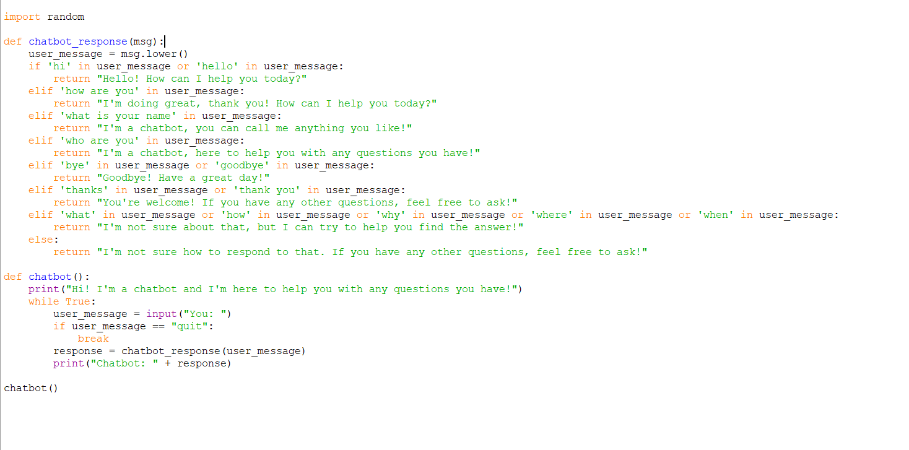
SAMPLE PYTHON PROGRAM OF CHATBOT:

Slide 12
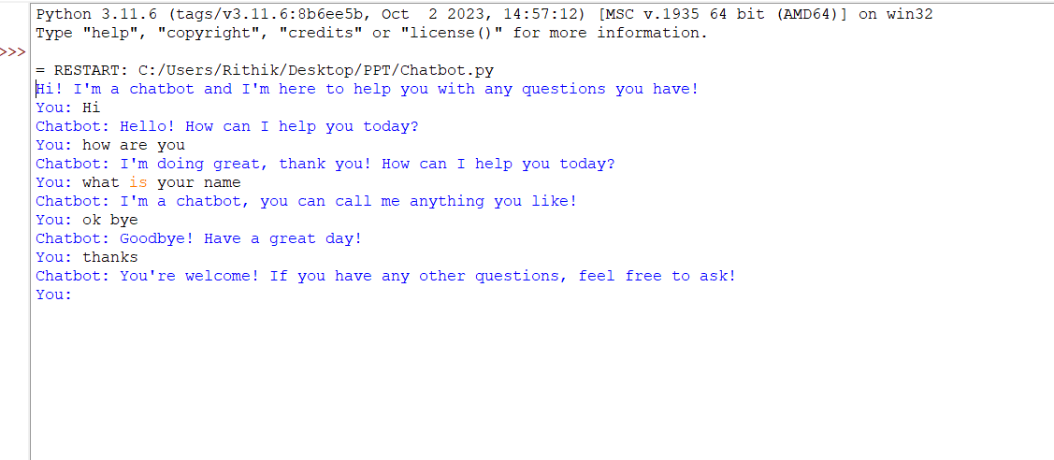
Output:

Slide 13
Ensemble methods:
Ensemble methods involve combining multiple models to improve the accuracy and robustness of the prediction system. This can be achieved through techniques such as bagging, boosting, and stacking.
Bagging:
Bagging involves creating multiple models using different subsets of the training data and aggregating their predictions. This can reduce overfitting and improve the accuracy and stability of the model.
Boosting:
Boosting involves creating a series of models that are trained sequentially, with each subsequent model focusing on the samples that were misclassified by the previous model. This can improve the accuracy of the model by focusing on the difficult samples.
Stacking:
Stacking involves combining the predictions of multiple models using a meta-model. The meta-model learns from the predictions of the base models and can improve the accuracy and robustness of the prediction system.

Slide 14
Deep learning architectures:
Convolutional Neural Networks (CNNs):
CNNs are widely used in image and video recognition tasks. They consist of multiple layers of convolutional and pooling operations that extract features from the input data.
Recurrent Neural Networks (RNNs):
RNNs are commonly used in natural language processing tasks. They have a feedback loop that allows them to process sequences of data, such as sentences or speech.
Generative Adversarial Networks (GANs):
GANs are used for generating new data that is similar to the training data. They consist of a generator network that creates new samples and a discriminator network that evaluates the quality of the generated samples.

Slide 15
Conclusion
In this phase, we explored innovative techniques such as ensemble methods, deep learning architectures, and pre-trained language models to improve the prediction system's accuracy and robustness. We also put our design into innovation by following a structured approach of problem statement, research and analysis, design and development, implementation and testing, documentation, and assessment.

